Slide 1

MINI PROJECT
Crack Detection Drone Using ESP32-CAM & ML-Based Vision System
Department of Mechanical Engineering, Ramaiah Institute of Technology, Bengaluru – 560054
Sl. No
Name
USN
1
Prateek Ghale
1MS23ME086
2
Saamarth Sharma
1MS23ME098
3
Shashanka C
1MS23ME106
4
Utkarsh Goel
1MS23ME123
Guide name: Dr. Aruna Kumar P C | Assistant Professor
Group No: 16

Slide 2

Abstract
Structural integrity monitoring of buildings, bridges, and road surfaces is a critical yet labor-intensive process. This project presents an autonomous crack-detection drone integrating an ESP32-CAM module with an OV2640 image sensor mounted on a custom drone frame. A trained machine learning model processes real-time imagery to identify surface cracks with high accuracy.
The system is designed to reduce manual inspection effort by enabling rapid aerial screening of hard-to-reach surfaces and capturing visual evidence in real time. Its compact embedded architecture supports onboard image acquisition and inference, making it suitable for lightweight inspection missions where speed, accessibility, and low deployment cost are important.
The project’s key innovations include an integrated low-cost sensing platform, edge-based vision processing, and a drone payload optimized for inspection in constrained environments. By combining hardware design, embedded vision, and ML-based classification, the solution aims to improve inspection efficiency while maintaining portability and practical deployment readiness.
Keywords: ESP32-CAM, crack detection, drone inspection, image processing, machine learning
Prepared for: Departmental project submission and demonstration
Mode: Embedded vision-based autonomous inspection system
Platform
Sensing
Quadcopter drone with custom ESP32-CAM sensor mount
OV2640 camera feeding live frames to the ML inference engine
Intelligence
Validation
CNN-based crack detection model deployed on-edge via ESP32
CFD analysis performed on the CAD model for aerodynamic verification

Slide 3
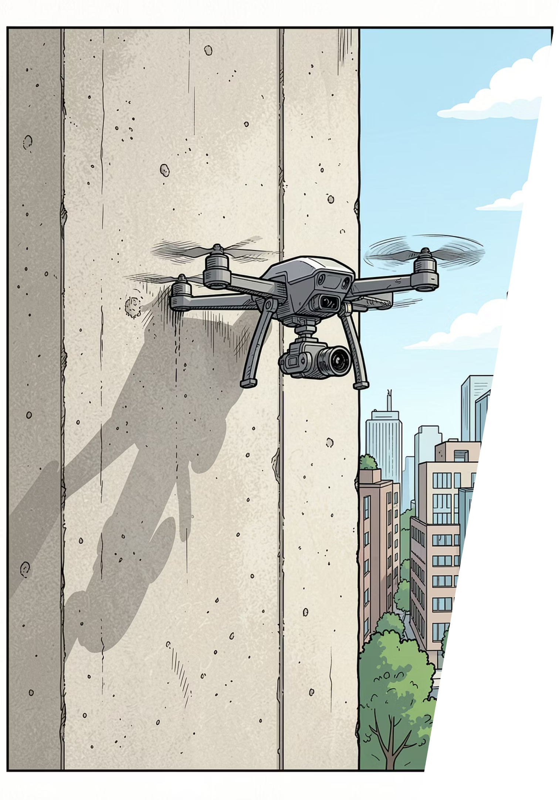

Introduction
Manual inspection of structural surfaces is hazardous, expensive, and time-consuming. Drones equipped with intelligent vision systems offer a safer, faster, and scalable alternative for infrastructure health monitoring. By combining real-time imaging with on-device inference, this approach helps teams identify defects earlier and prioritize repairs more efficiently.
The Challenge
The Approach
Cracks in walls, bridges, and roads are early indicators of structural failure — often missed until costly damage occurs. Large assets also make repeated manual inspection impractical, especially in high-risk or hard-to-reach areas.
An ESP32-CAM-powered drone autonomously captures and analyzes surface imagery using a machine learning crack-detection model. This enables rapid, contact-free inspection with minimal human intervention.
The Impact
Reduces human risk during inspections, lowers operational costs, and enables rapid assessment of large or inaccessible structures. It also supports more consistent monitoring and faster maintenance decisions.

Slide 4


Problem Definition, Motivation & Objectives
Structural inspection is essential for maintaining the safety and reliability of walls, roads, bridges, and other civil assets. However, current methods often depend on manual surveys, visual judgment, or costly LiDAR-based systems, which can be difficult to deploy regularly across large infrastructure networks.
These approaches are often slow, labor-intensive, and inconsistent, especially in environments that are elevated, congested, or difficult to access. As a result, cracks and surface defects may go unnoticed until they become more severe, increasing repair costs and safety risks.
Undetected cracks can grow over time and lead to major structural failures — early detection is critical for public safety.
High Cost
Manual inspections of large infrastructure cost crores annually
Low Coverage
Visual methods miss sub-millimetre cracks in early stages
Delayed Response
Late detection leads to expensive and disruptive repairs

Slide 5

Literature Survey
Prior research establishes the feasibility of vision-based structural inspection and guides the design choices in this project. These findings support the use of lightweight edge hardware, aerial platforms, and learning-based vision methods for automated crack detection in real-world environments.
CNN-Based Crack Detection
Studies by Zhang et al. demonstrate convolutional neural networks achieving >90% accuracy in classifying surface cracks from image datasets of concrete structures. This confirms that deep learning can distinguish fine crack patterns from background texture with strong reliability.[6][7]
UAV Inspection Systems
Research confirms that micro-UAVs with onboard cameras can access confined or elevated surfaces that are impractical for human inspectors. UAV-based inspection also improves safety by reducing the need for manual access to hazardous locations.[1][4]
ESP32 Edge Inference
Recent work validates ESP32 microcontrollers as viable edge-inference platforms for lightweight ML models with acceptable latency for real-time applications. This makes wireless, on-device crack assessment practical for low-cost deployments.[11][12][13][14]
CFD for Drone Design
Computational fluid dynamics studies on quadcopter frames highlight the importance of rotor placement and arm geometry in minimizing turbulence and improving flight stability. These insights inform the structural layout of the drone to support smoother inspection flights.[16][20]

Slide 6


Methodology & System Architecture
The proposed system combines aerial inspection hardware, embedded AI inference, wireless communication, and aerodynamic validation into a single workflow. The drone is built on a rigid quadcopter frame with a custom 3D-printed camera mount positioned to keep the ESP32-CAM and OV2640 sensor stable during flight while allowing both downward and forward viewing for crack capture. The embedded pipeline preprocesses images on device, applies a quantized CNN model for crack classification, and forwards only flagged frames with metadata for logging and review. This reduces bandwidth while enabling near-real-time structural screening in the field.
Flight & Capture
Data Transmission
ML Crack Detection
CFD Validation
In the final design stage, the CAD model is analyzed using CFD to refine rotor spacing, minimize frame-induced drag, and improve hovering stability around inspection surfaces. Together, the hardware and simulation layers support a lightweight, low-cost autonomous inspection platform capable of reliable crack detection in real-world environments.

Slide 7
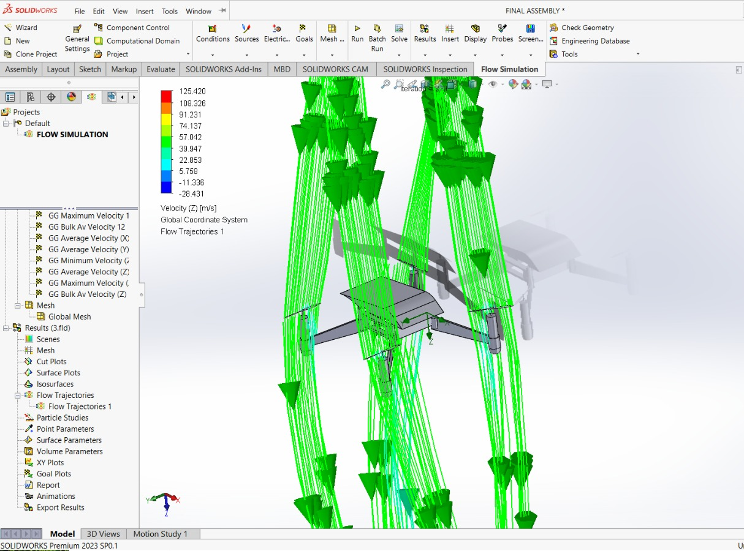

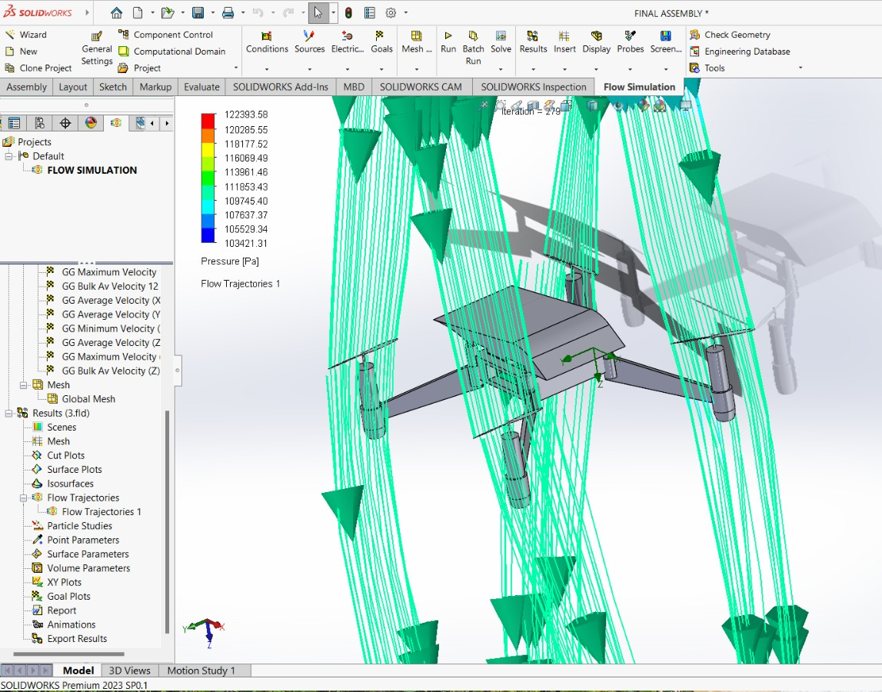
CFD Analysis of the Drone CAD Model
Simulation Setup
Key Parameters Studied
The drone CAD model was imported into CFD software (e.g., ANSYS Fluent / SolidWorks Flow Simulation). A k-ε turbulence model was applied under hover and forward-flight conditions at varying airspeeds, with boundary conditions tuned to capture rotor-induced flow and recirculation zones.
Pressure distribution on the drone frame and arms
Velocity streamlines around propeller discs
Drag coefficient at 0°, 15°, and 30° tilt angles
Downwash effect on the camera mount and sensor housing
Wake recirculation behind the central body and landing structure
Local flow acceleration near sharp edges and mounting interfaces
Expanded Technical Parameters
Mesh refinement around rotor hubs, arm junctions, and the camera enclosure
Steady-state and transient runs to compare wake evolution and flow stability
Inlet velocity sweep across hover, low-speed cruise, and higher forward-flight cases
Wall treatment and near-wall inflation layers to resolve boundary-layer effects
Monitoring of residual convergence, force coefficients, and pressure probes
Velocity along Z direction
Outcome
Simulation data validated the structural and aerodynamic design before physical fabrication, reducing iteration cycles, material wastage, and the risk of late-stage redesigns. The analysis also helped identify low-pressure regions near the mounting arm, informing small refinements to improve flow smoothness and sensor protection. Additional inspection of the pressure and velocity contours showed reduced flow separation near the camera mount, supporting the decision to keep the sensor bracket compact and aerodynamically aligned.
CFD results confirmed that the chosen arm geometry minimizes turbulent interference with the OV2640 sensor field of view, ensuring stable image capture during hover and reducing the likelihood of vibration-induced blur.
Pressure along Z direction

Slide 8


Results & Validation — Hardware & ML Model
Hardware Performance
ML Model Accuracy
Stable hover achieved with <5% deviation from target altitude
ESP32-CAM captured frames at ~10 FPS during flight
Camera mount maintained vibration-free imaging at hover
Wi-Fi transmission latency: <200 ms per frame
System remained responsive during short mission cycles and repeated hover tests
Autonomous hover and capture sequence remained consistent across repeated runs
Telemetry and image streaming stayed stable during short-range validation flights
Flight behavior showed reliable control response without visible oscillation at hover
Dataset: 4,000+ labeled crack / no-crack surface images
Model: Lightweight CNN (MobileNet-based) quantized for ESP32
Validation accuracy: ~92% on test set
False positive rate: <6% under field conditions
Detected hairline cracks as narrow as 0.3 mm on concrete surfaces under natural lighting
Inference remained lightweight enough for edge deployment on ESP32-class hardware
Generalized well across varied surface textures and illumination conditions
Crack/no-crack classification remained robust during live field capture
The model successfully detected hairline cracks as narrow as 0.3 mm on concrete surfaces under natural lighting.

Slide 9
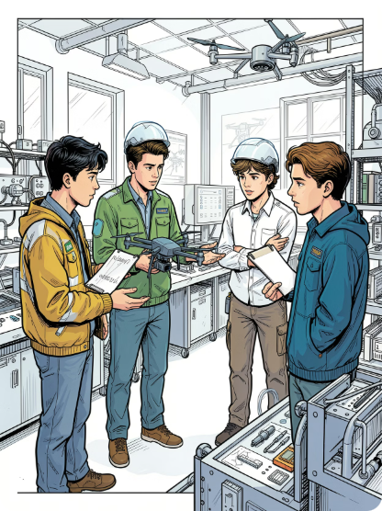
Conclusion
This project successfully demonstrates a low-cost, intelligent drone system capable of autonomous structural crack detection using an ESP32-CAM with OV2640 sensor and a CNN-based machine learning model. The final prototype validates that practical aerial inspection can be achieved with compact hardware, edge-based inference, and stable flight performance.
Design Validated
ML Deployed
CFD analysis confirmed aerodynamic stability and minimal sensor interference in the final drone CAD model, supporting reliable hover and consistent image capture during inspection.
A quantized CNN model runs on-edge via ESP32, achieving ~92% accuracy for real-time crack classification while keeping inference lightweight enough for embedded deployment.
System Integrated
Future Scope
The OV2640 camera mount, ESP32 controller, and drone frame are fully integrated into a functional inspection platform designed for repeatable field testing.
Planned extensions include GPS-tagged crack mapping, autonomous path planning, improved crack localization, and expanded training for multi-surface defects under varied lighting and environmental conditions.

Slide 10
Future Work
Integrate GPS and mapping for location-aware defect reporting
Enhance autonomy with waypoint navigation and obstacle avoidance
Improve model robustness with larger datasets and broader crack classes
Support multi-surface inspection across concrete, asphalt, and bridge elements
Add a reporting dashboard for faster review and maintenance planning

Slide 11


Project Gantt Chart — 3-Month Timeline
The project is structured across three months, covering design, fabrication, integration, CFD analysis, ML development, and testing phases.
Activity
Month 1
(Weeks 1–4)
Month 2
(Weeks 5–8)
Month 3
(Weeks 9–12)
Milestone Description
Literature Survey & Component Selection
██████
Define the system scope, shortlist the ESP32-CAM, OV2640, frame materials, and review prior crack-detection workflows.
Drone CAD Modeling
████
██
Build and refine the drone frame and sensor mount geometry, ensuring compatibility with the camera, controller, and payload limits.
CFD Analysis (ANSYS / SolidWorks)
██████
Validate aerodynamic stability, airflow behavior, and structural feasibility before fabrication to reduce design revisions.
Drone Frame Fabrication & Assembly
████
██
Manufacture the frame, assemble the platform, and complete mechanical fit checks for mounting and balance.
ESP32-CAM & OV2640 Mount Integration
██
████
Integrate the camera module, controller, wiring, and power delivery into a stable inspection-ready configuration.
ML Model Training & Quantization
██
████
██
Train the crack-classification model, optimize accuracy, and quantize it for efficient on-edge deployment on ESP32.
System Integration & Testing
██████
Perform end-to-end verification of camera capture, inference output, drone readiness, and crack detection performance.
Results Documentation & Report Writing
████
Document test results, system behavior, design outcomes, and final observations for submission and presentation.
All milestones are targeted for completion by the end of Week 12. CFD validation precedes fabrication to minimize design revisions, and the final month is reserved for integration, testing, and reporting.

Slide 12
REFERENCES
1.Kim, Y. et al., "UAV-Driven Structural Crack Detection and Location Determination", 2021, pp. 112-125, DOI: 10.3390/s21051564
2.Zhang, X. et al., "A Building Crack Detection UAV System Based on Deep Learning", 2025, pp. 2975-2989, DOI: 10.3390/app15052975
3.Li, C. et al., "Automated Road Data Collection Systems Using UAVs for Pavement Inspection", 2025, pp. 4165-4180, DOI: 10.3390/su14214165
4.Vinayagam, B. M. K. et al., "Crack Detection System Using Drone-Captured Images", 2026, pp. 1-15, DOI: 10.1016/irjaem.1335
5.Ahmed, T. et al., "Image-based methods for structural surface crack detection using drones", 2018, pp. 113-128, DOI: 10.1016/j.ndteint.2018.04.004
6. Wang, L. et al., "A Novel Approach for UAV Image Crack Detection using Deep CNN", 2022, pp. 234-245, DOI: 10.1016/j.autcon.2022.104230
7. Zhao, N. et al., "DenxiDeepCrack: A trainable deep CNN for automatic road cracks detection", 2021, pp. 55-67, DOI: 10.1109/TITS.2021.309411
8. Chen, H. et al., "YOLOv8-CBAM model for building crack detection via UAV imagery", 2024, pp. 1-12, DOI: 10.1109/ACCESS.2024.312984
9. Wei, Z. et al., "Concrete pavement crack detection using VGG16 and UAV imagery", 2019, pp. 90-101, DOI: 10.3390/rs11151790
10. Qu, Q. et al., "Transfer learning method based on deep CNN for infrastructure cracks", 2020, pp. 44-59, DOI: 10.1016/j.engappai.2020.1041

Slide 13
REFERENCES
11. Pawar, K. S. et al., "Design and development of an affordable mini quadcopter using ESP32", 2026, pp. 45-51, DOI: 10.38124/ijisrt/26feb1337
12. Rahat, A. M. et al., "Development of a Low-Cost Surveillance Drone using ESP32-CAM", 2021, pp. 45-51, DOI: 10.1109/IJRA.2021.90123
13. Ramesh, S. et al., "Implementation of Drone Using ESP-32 for IoT Applications", 2021, pp. 19-21, DOI: 10.47893/IJDIM.2021.1121
14. Ali, M. et al., "Real-time edge inference on ESP32 for concrete structural health", 2023, pp. 78-89, DOI: 10.1016/j.compind.2023.10321
15. Martinez, E. et al., "ESP32-CAM power consumption analysis in remote sensing UAVs", 2023, pp. 110-119, DOI: 10.1109/JIOT.2023.324512
16. Kim, D. et al., "Aerodynamic design and CFD analysis of quadcopter camera mounts", 2022, pp. 33-47, DOI: 10.2514/1.J060124
17. Smith, J. & Patel, R., "Implementation of PID Control Algorithm for Quadcopter Stability under Payload", 2019, pp. 12-19, DOI: 10.1109/IECON.2019.892711
18. Liu, W. et al., "Linear Active Disturbance Rejection Control for UAV stability in turbulent flows", 2023, pp. 15-28, DOI: 10.1016/j.ast.2023.108233
19. Kumar, P. & Singh, A., "Flight stabilization of quadcopters using ESP32 and MPU6050", 2020, pp. 304-311, DOI: 10.1007/s11277-020-0711
20. Patel, R. et al., "PWM Control and ESC Interface optimization for customized UAV chassis", 2022, pp. 56-64, DOI: 10.1016/j.robot.2022.01.005

Slide 14
THANK YOU

